Slide 1


Slide 2


Slide 3
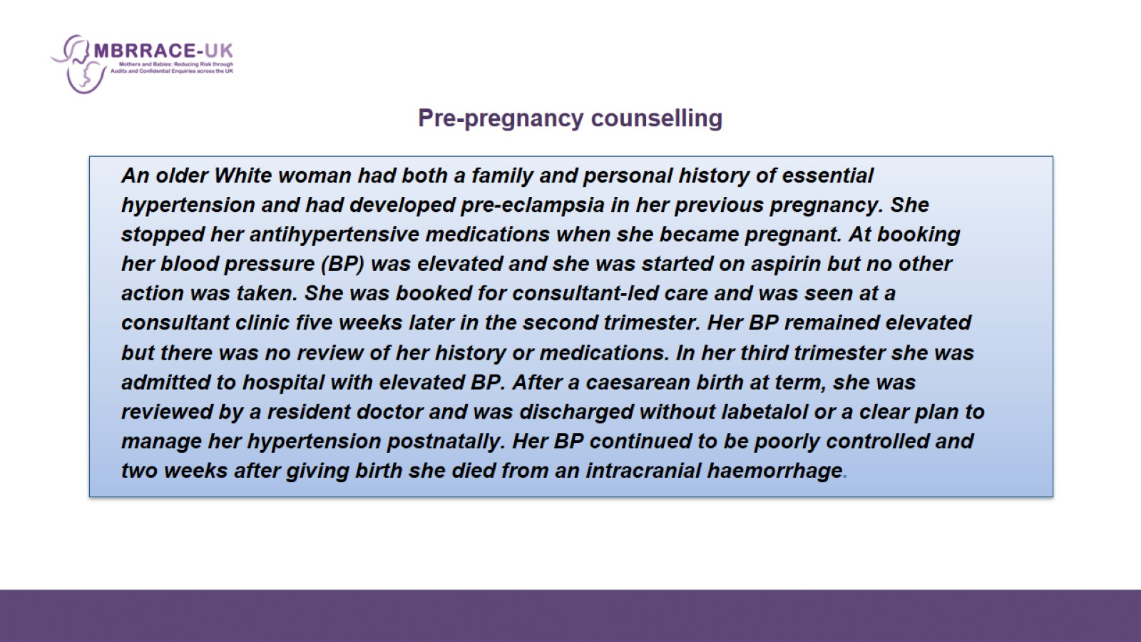
    Pre-pregnancy counselling

Slide 4
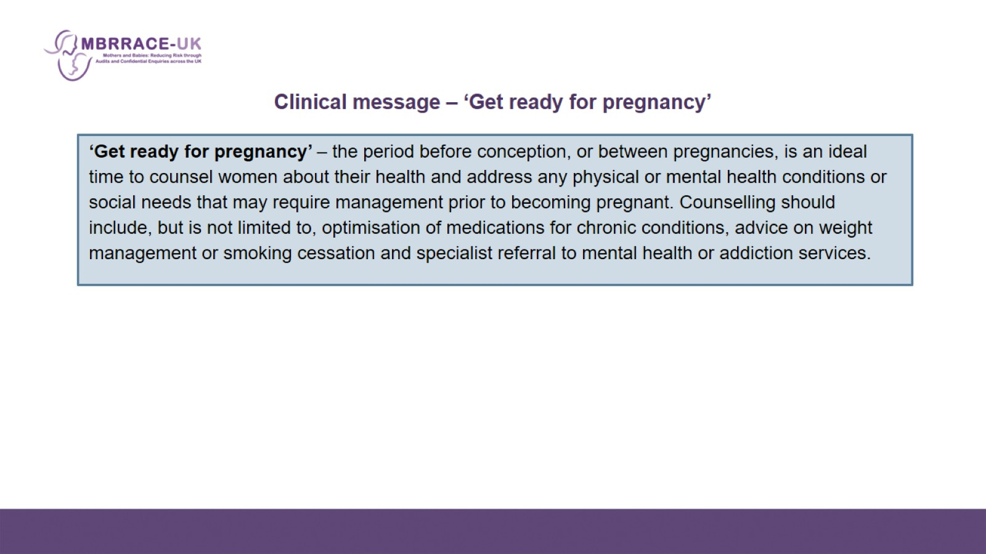
    Clinical message – ‘Get ready for pregnancy’

Slide 5
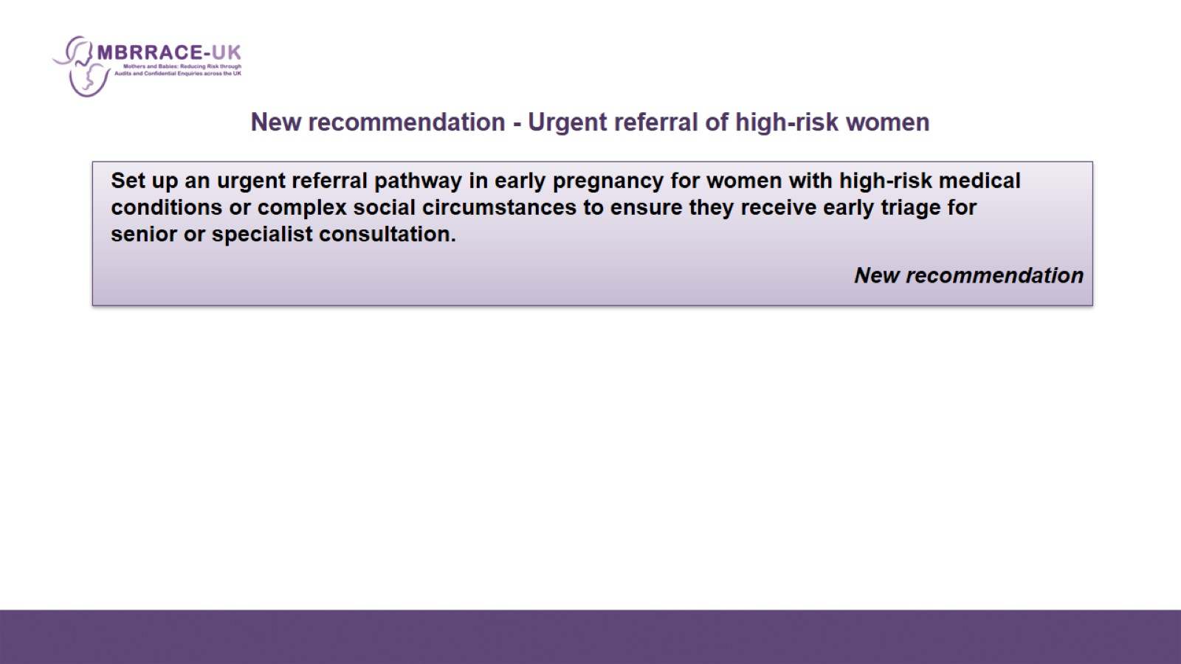
    New recommendation - Urgent referral of high-risk women

Slide 6
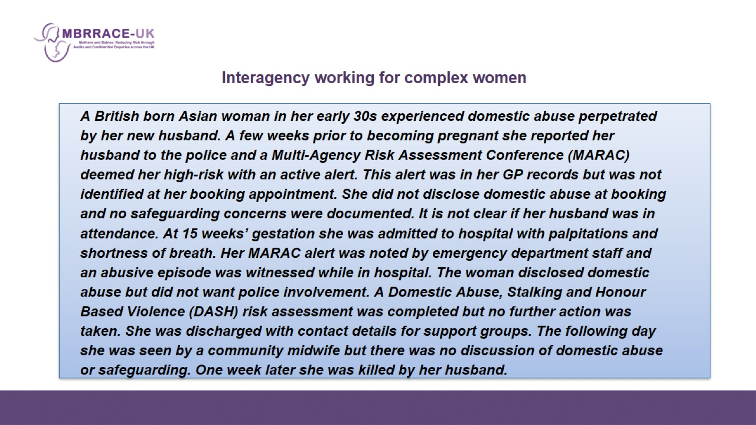

Slide 7
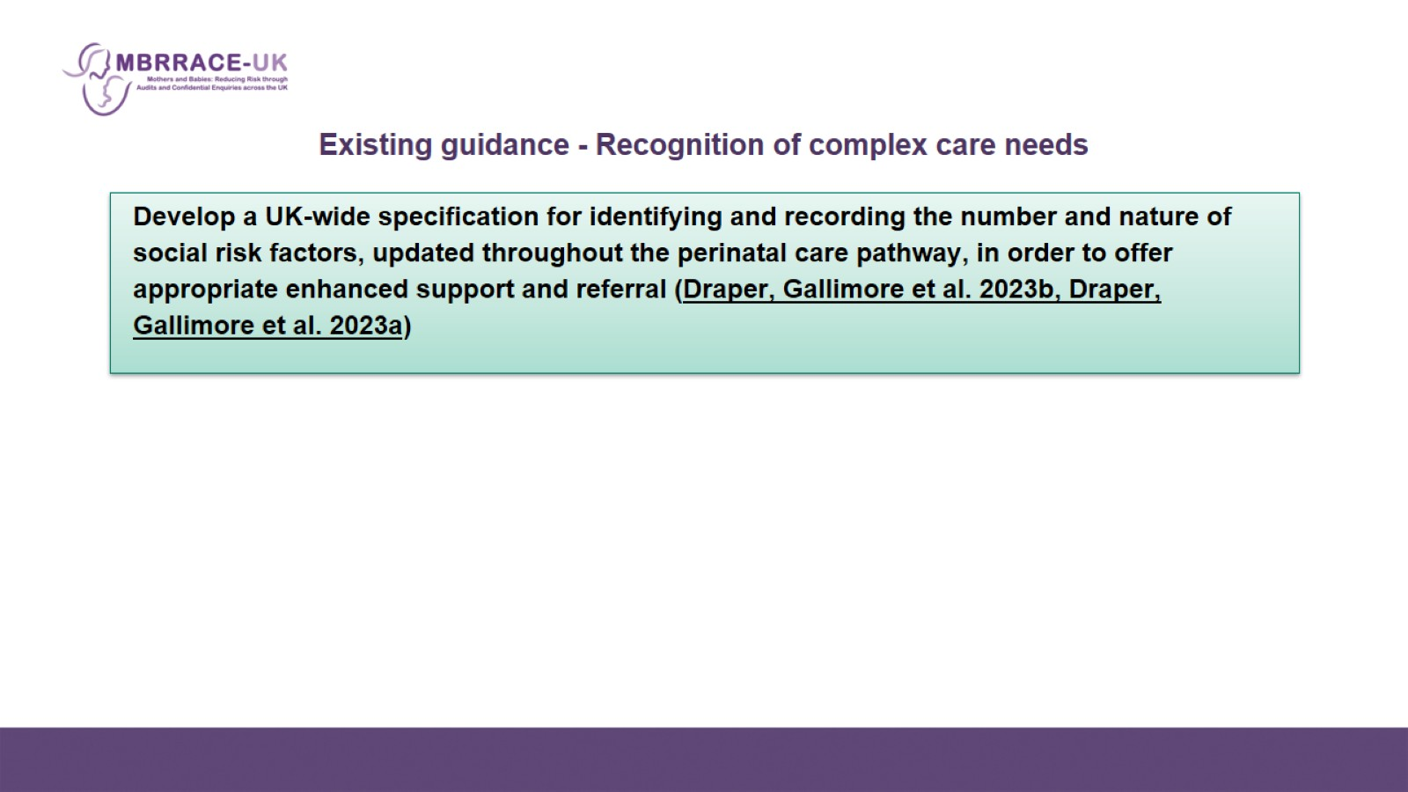
Existing guidance - Recognition of complex care needs

Slide 8
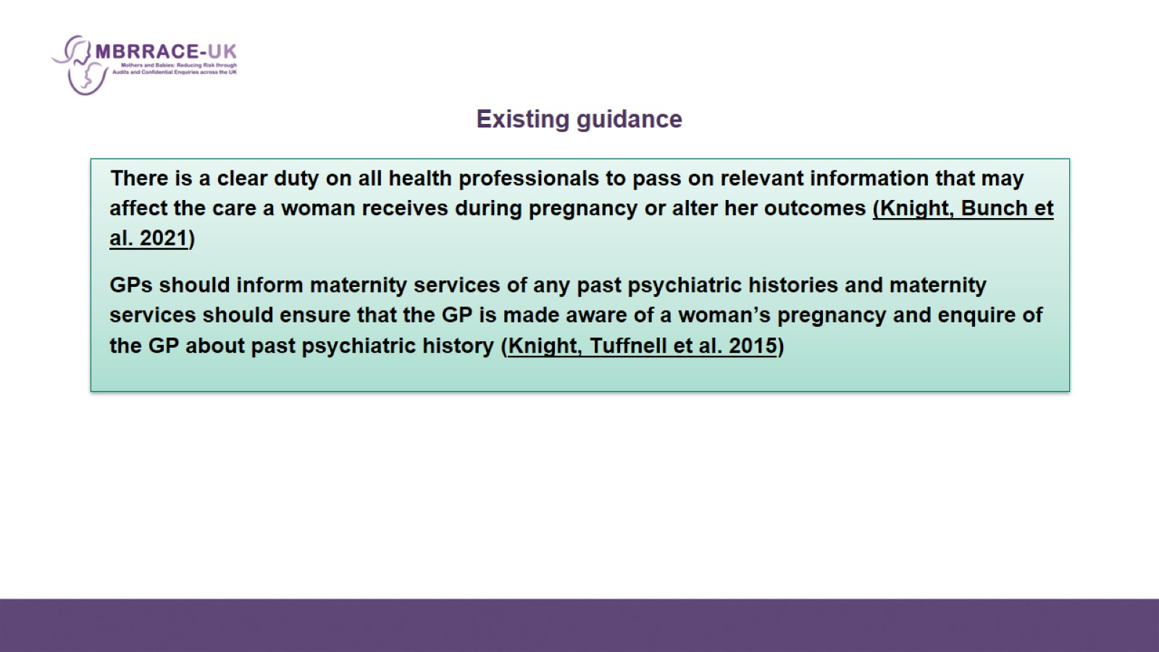
Existing guidance

Slide 9
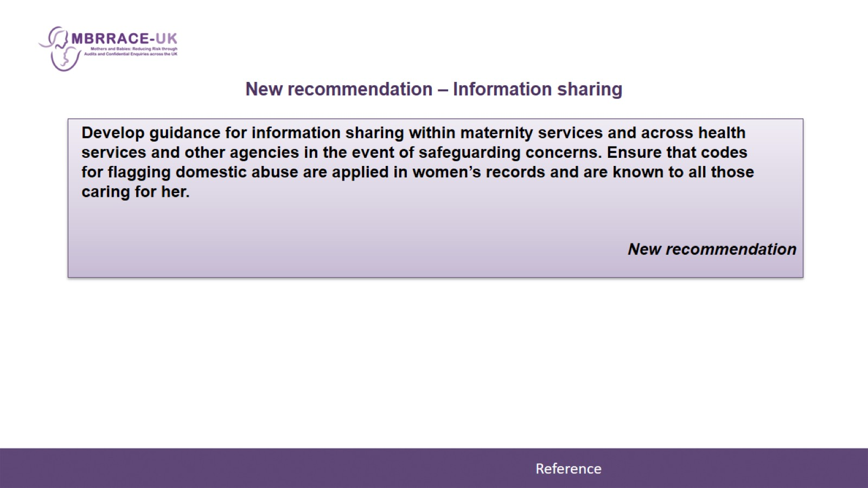
New recommendation – Information sharing

Slide 10
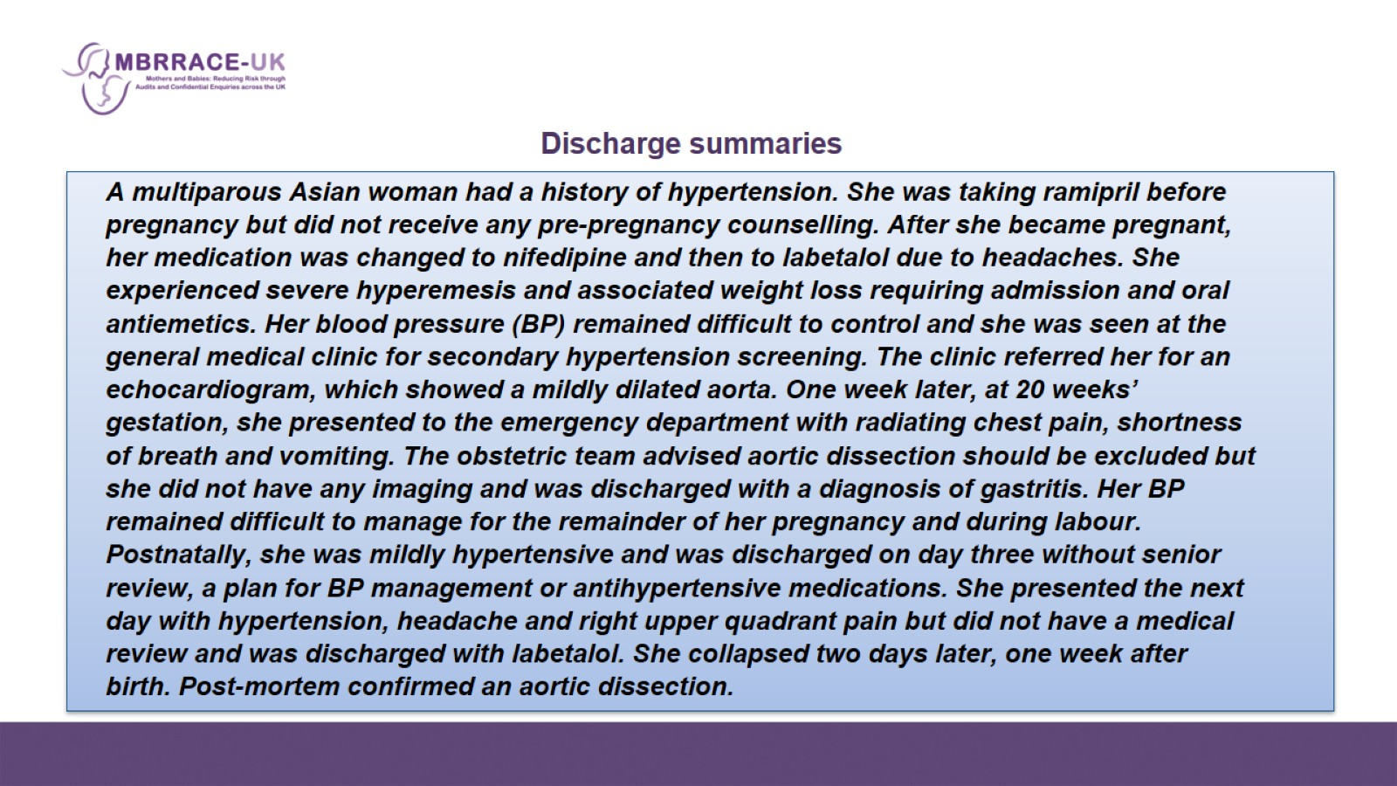

Slide 11
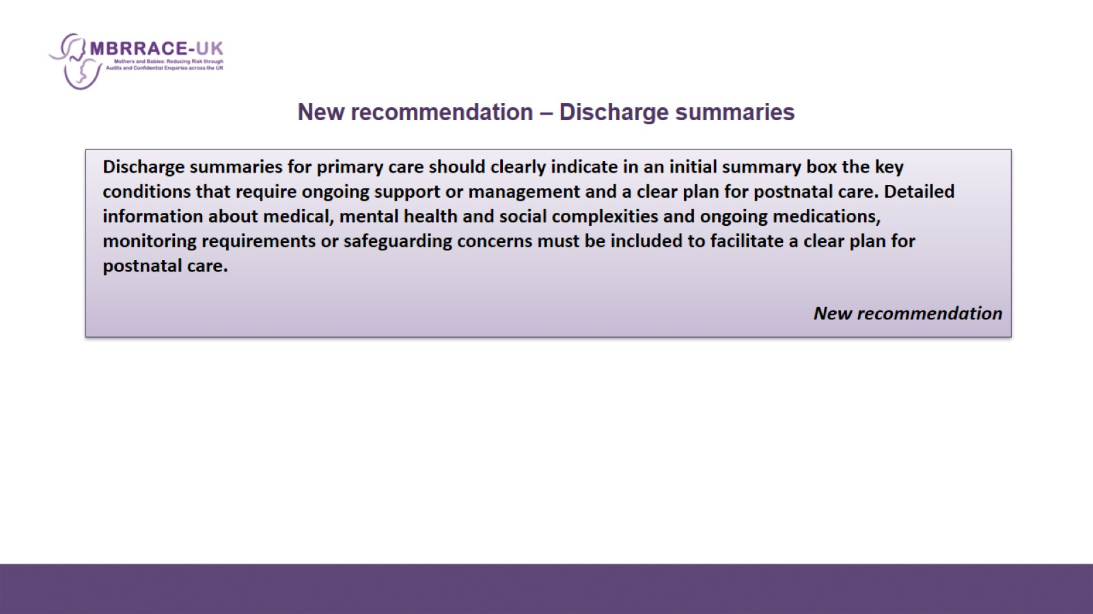
New recommendation – Discharge summaries

Slide 12
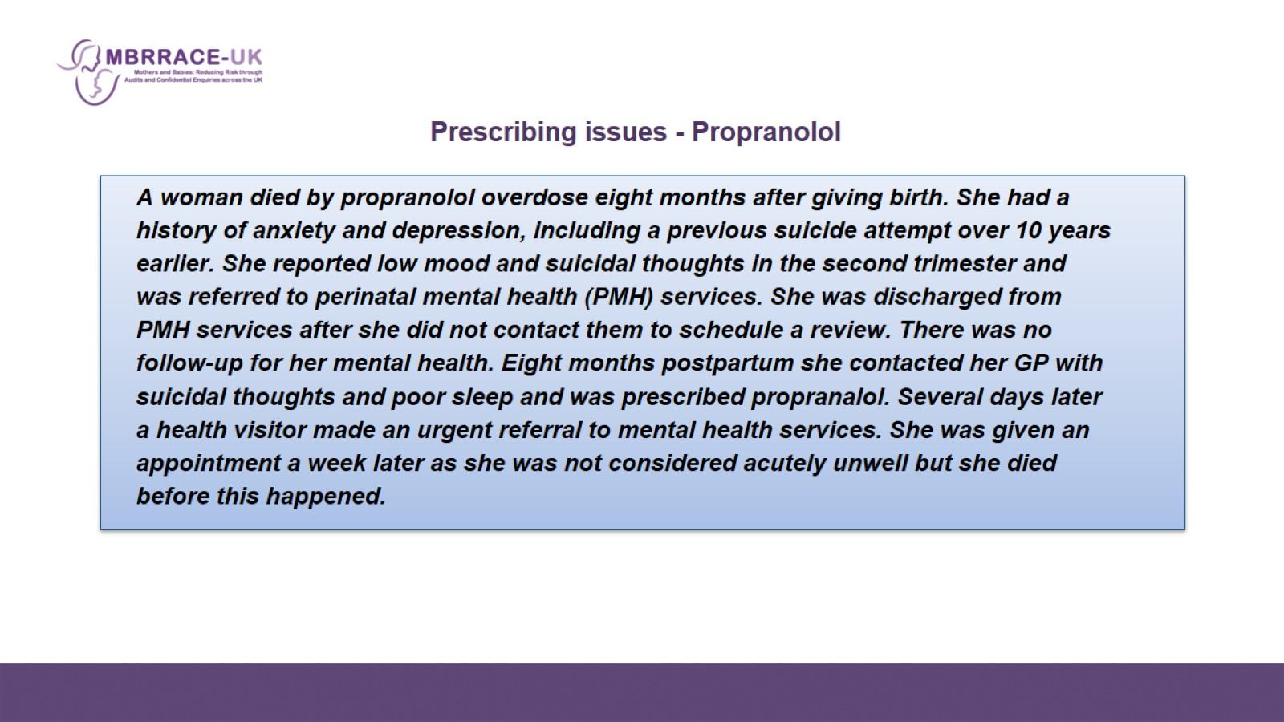

Slide 13
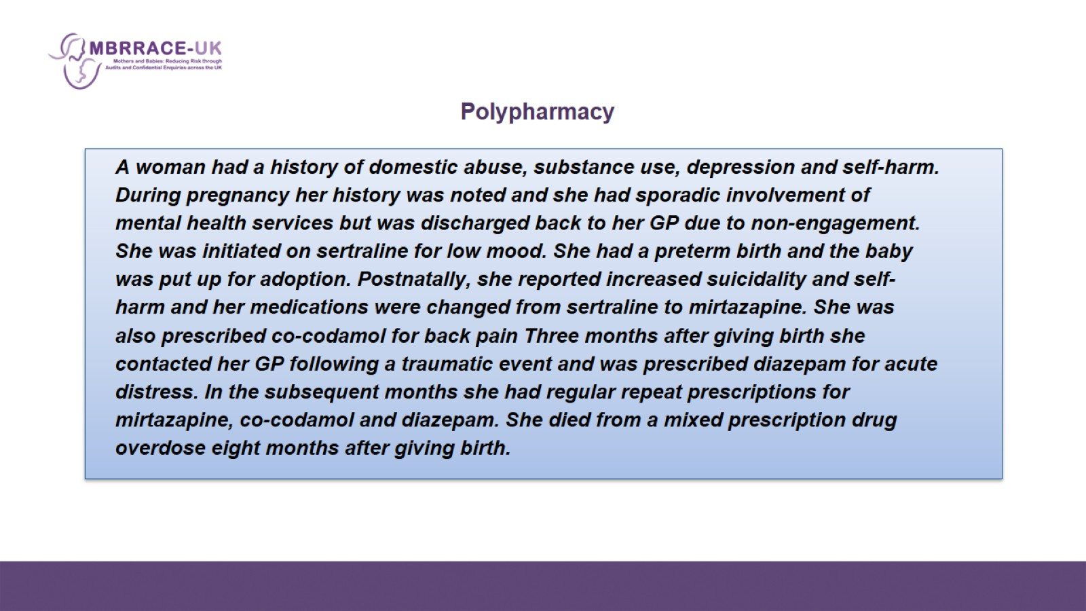

Slide 14
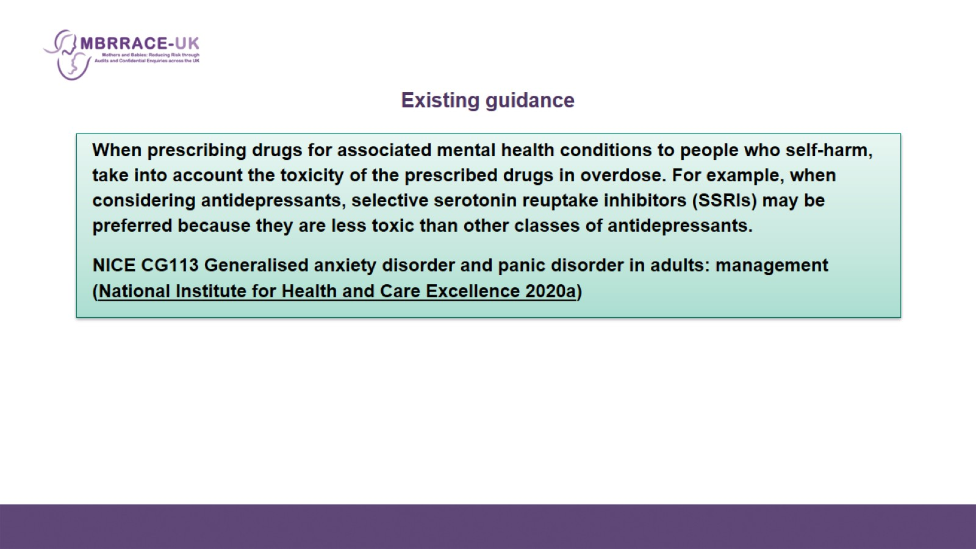
Existing guidance

